Slide 1
Poverty Demographics and Food Assistance Locations
DataCrunch ’15
Christine Grassi
Kruthika Potlapally
Gunes Yucel

Slide 2
Demographics of 4 Counties is NC
9 million NC’ians
1.6 million live below the poverty line
17.5 % of NC’ians below the poverty level
24.9% of children below the poverty level

Slide 3
Poverty Levels of Each City
Durham
Durham

Slide 4
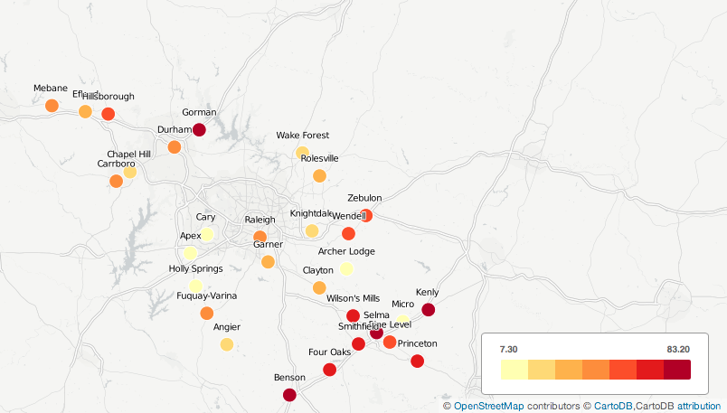
Percent of Children in Poverty in Each City

Slide 5
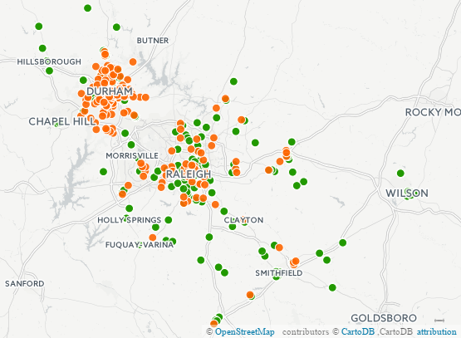
Closest Location of Feeding Sites to Food Pantries

